Slide 1
Working diagram and data sources
Nutrient diversity in the food system
Sold diversity
System diversity
Catch diversity
Consumption diversity
Nutrient diversity in household diets
Biomonitoring data
CFR-level
Catch and consumption monitoring data
Household-level
Nutrient database
Species-level

Slide 2
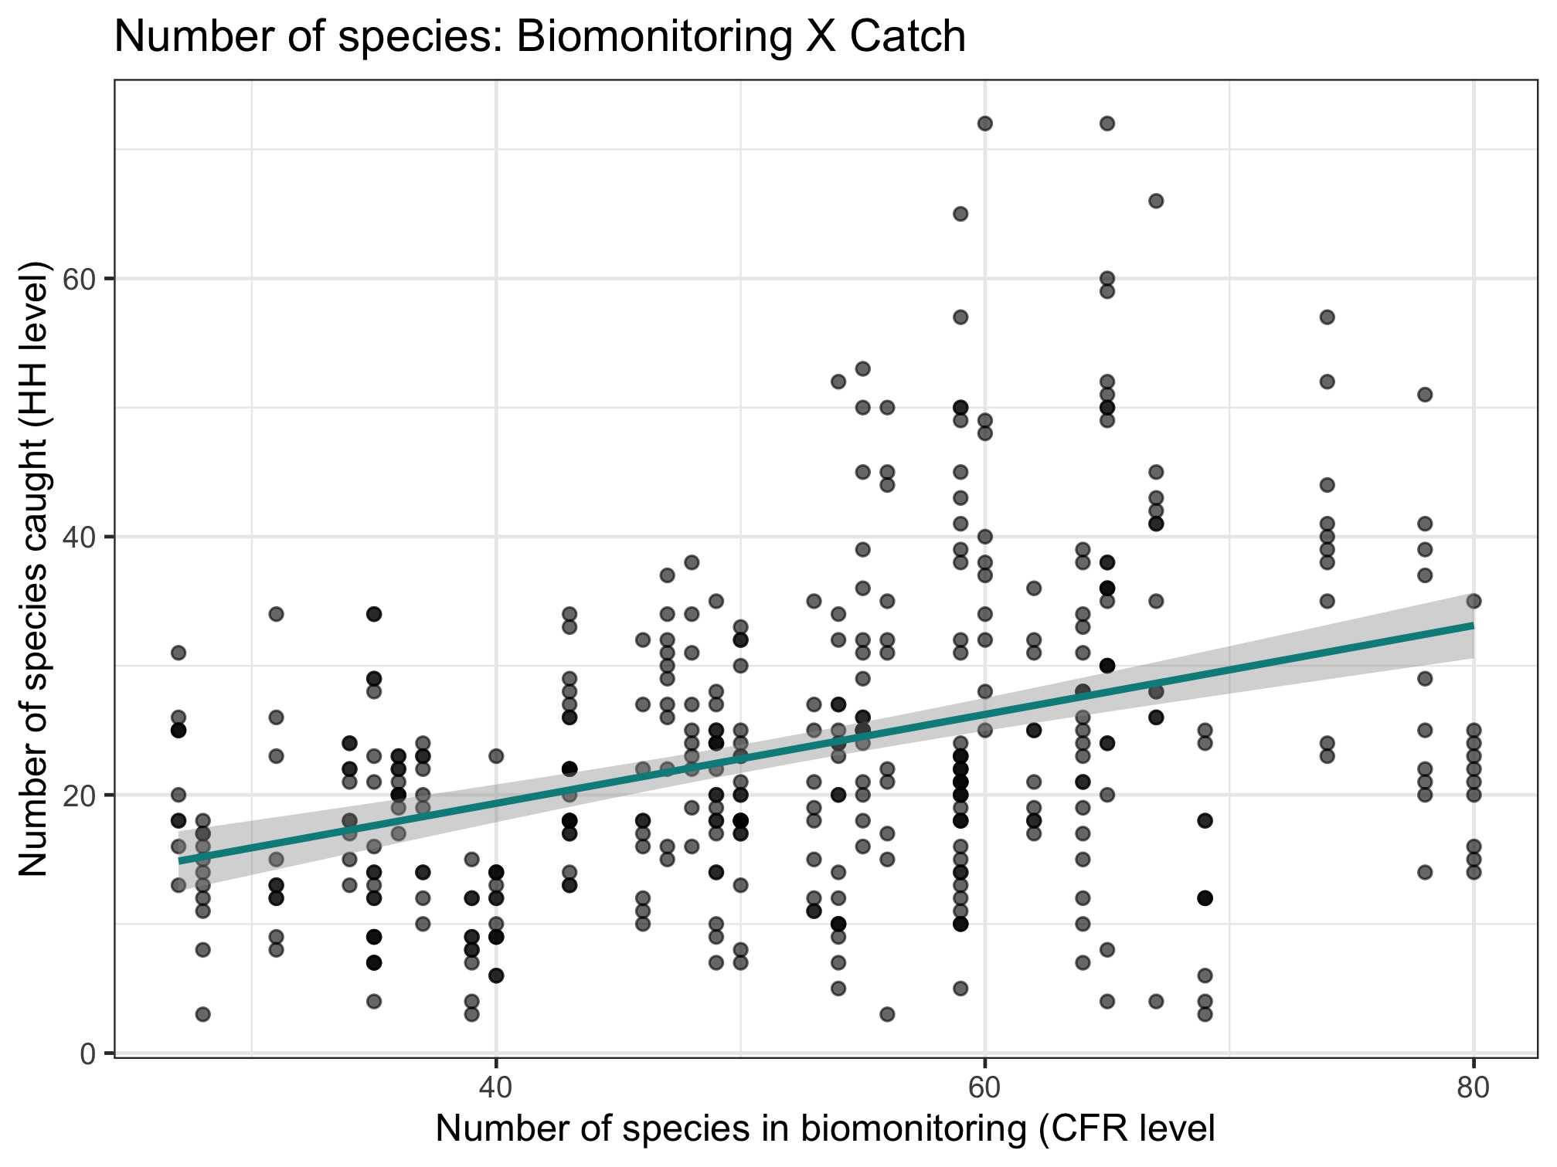
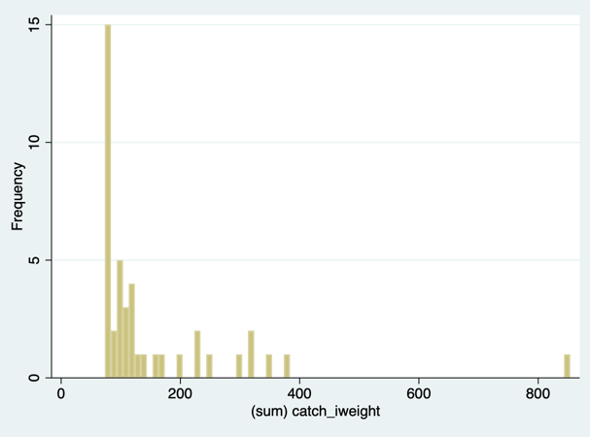
Nutrient diversity in the food system
Sold diversity
Slope = 0.384
System diversity
Catch diversity
Consumption diversity
Nutrient diversity in household diets

Slide 3
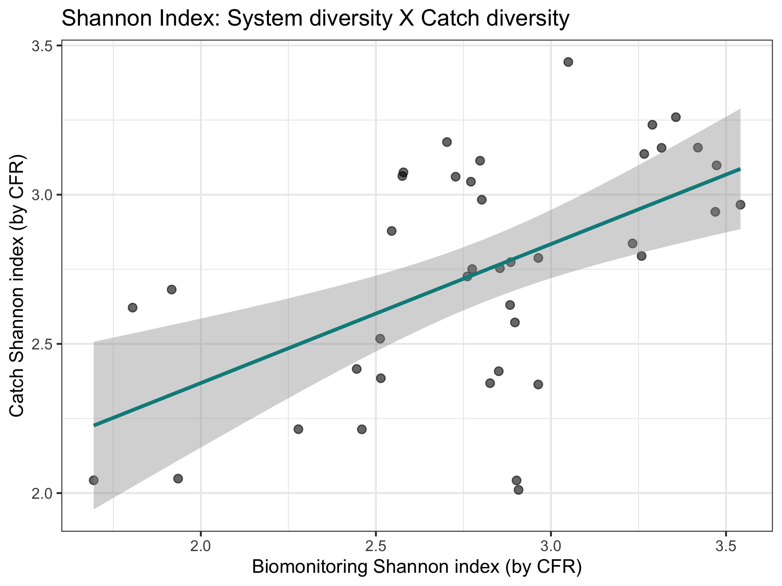
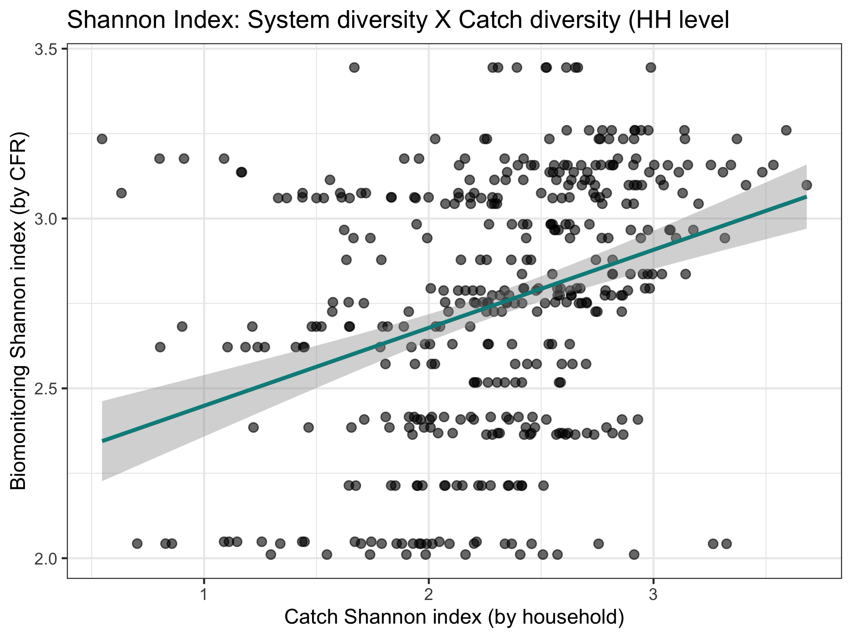
Color code by CFR type, maybe CFR size
Nutrient diversity in the food system
Sold diversity
Slope = 0.486
System diversity
Catch diversity
Consumption diversity
Nutrient diversity in household diets
Slope = 0.376

Slide 4
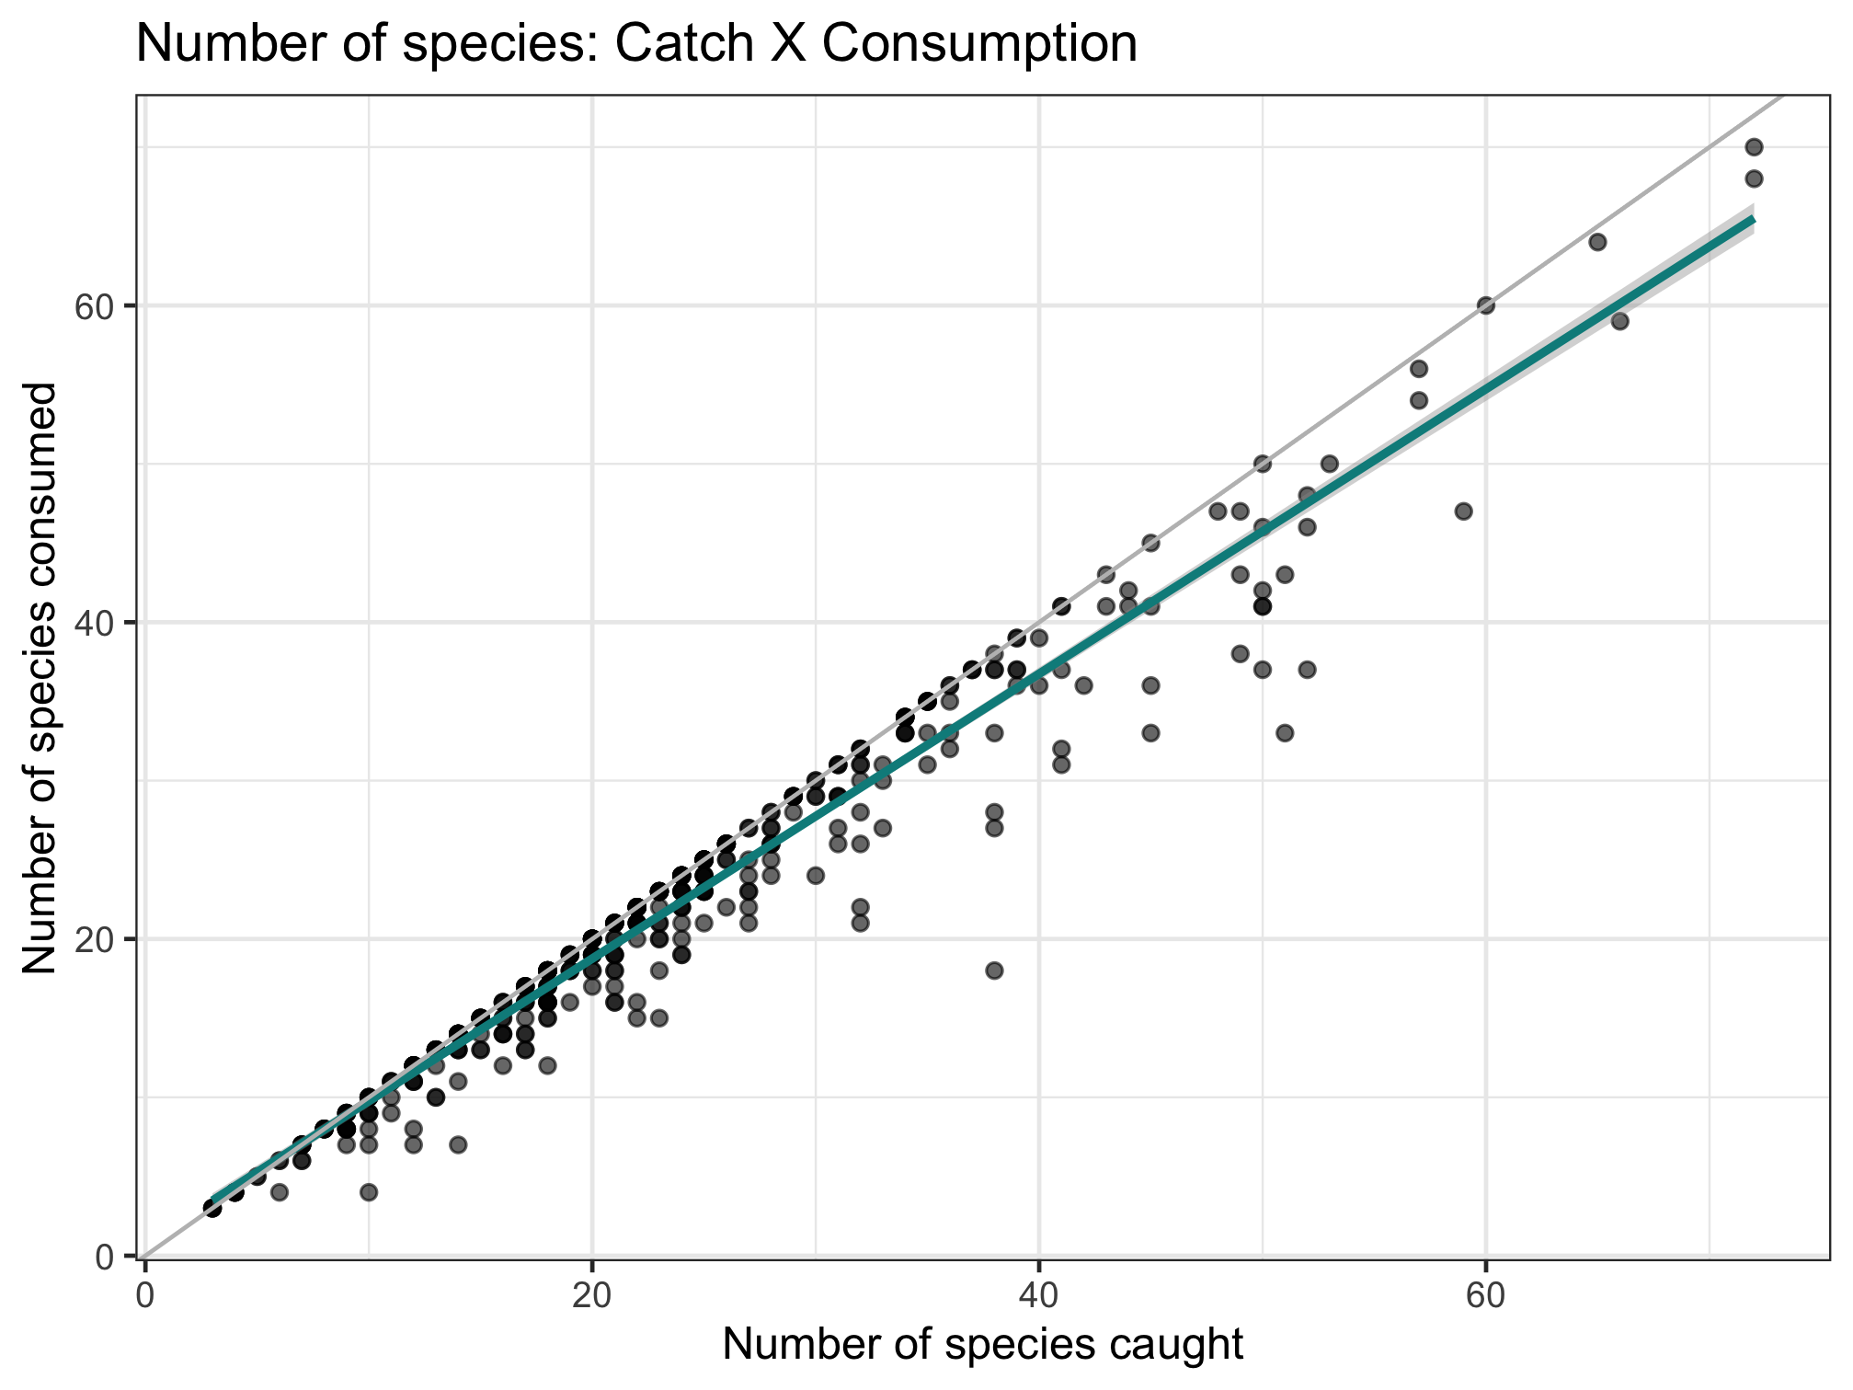
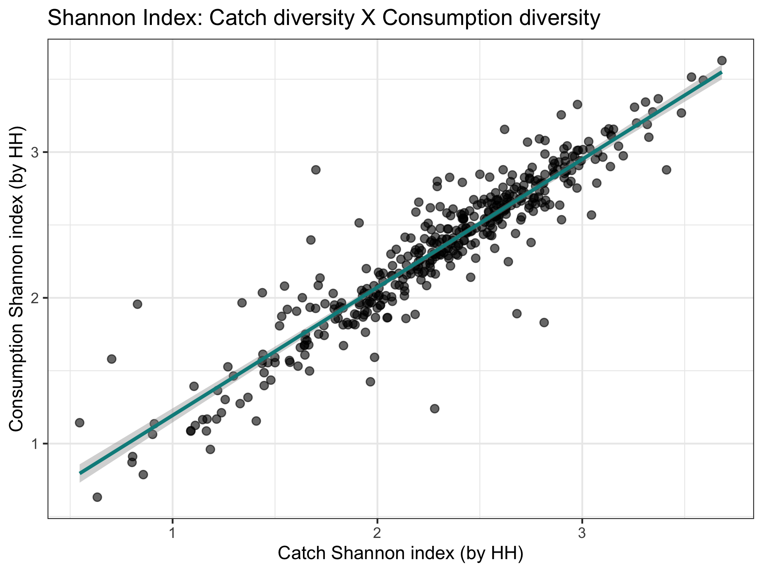
Nutrient diversity in the food system
Sold diversity
Slope = 0.979
System diversity
Catch diversity
Consumption diversity
Nutrient diversity in household diets
Slope = 0.924

Slide 5
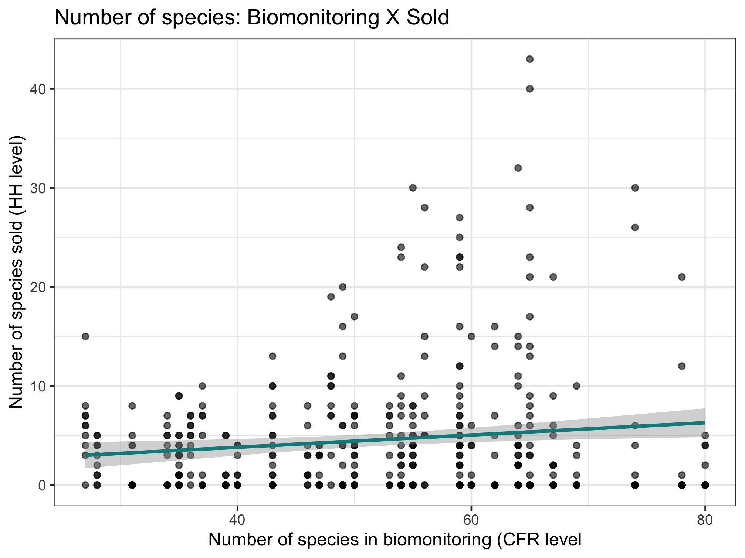
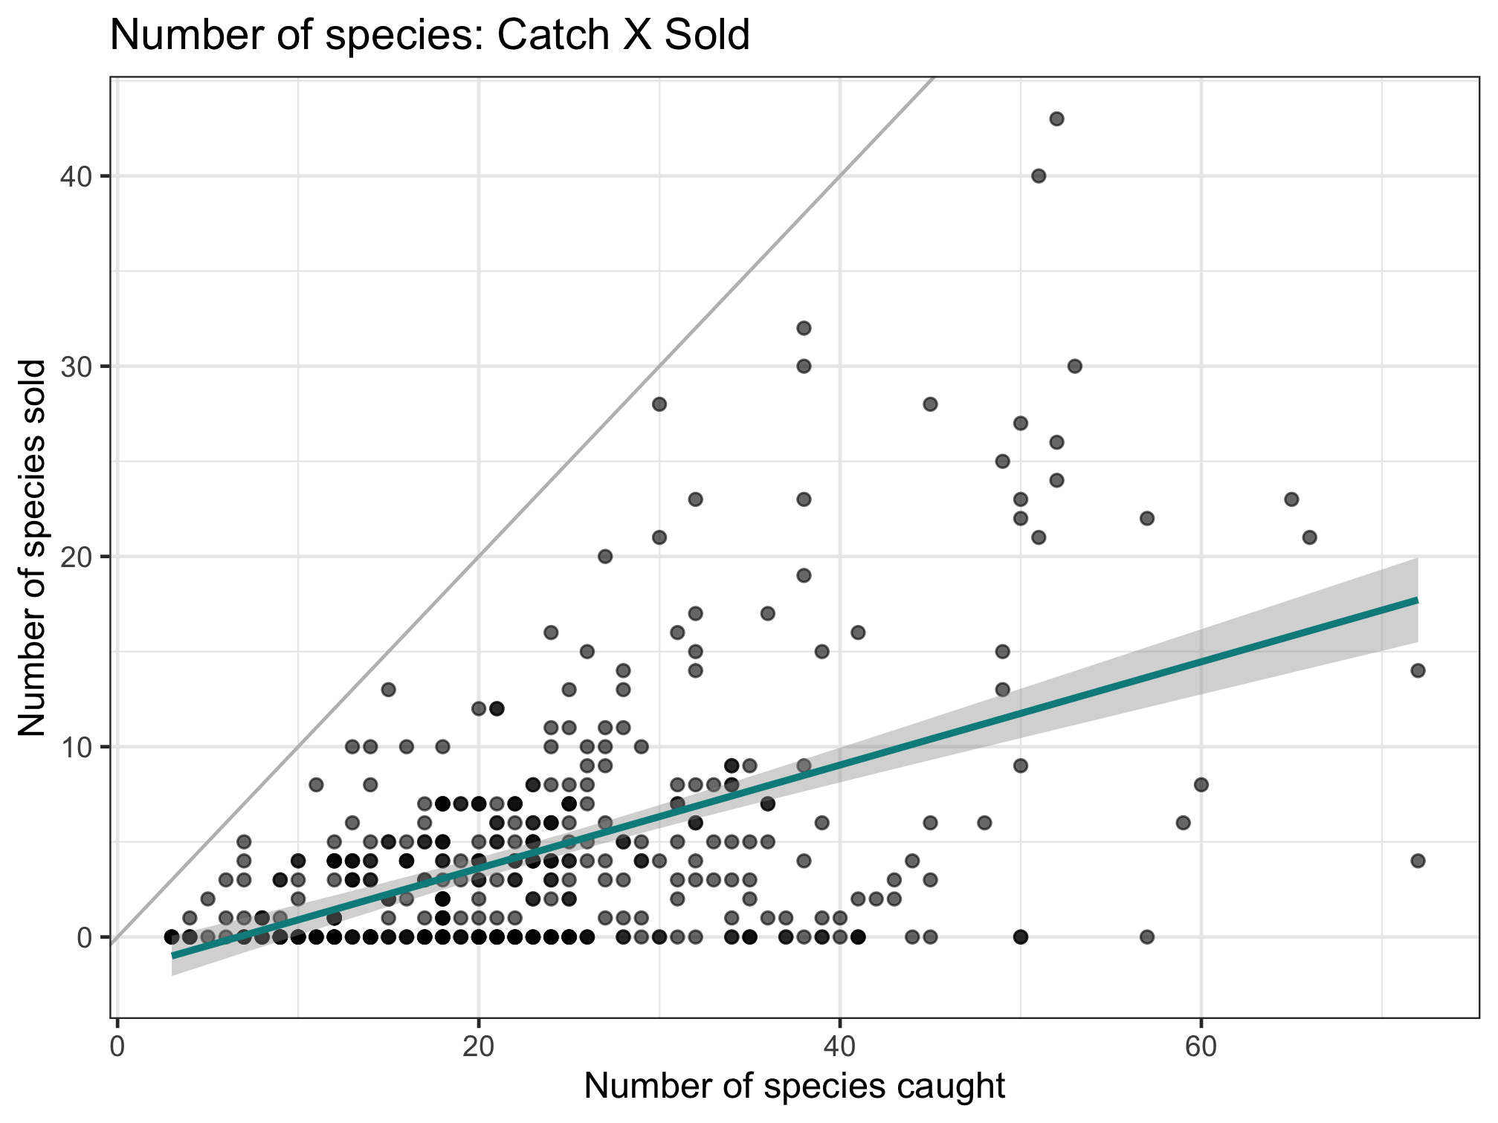
Nutrient diversity in the food system
Sold diversity
System diversity
Catch diversity
Consumption diversity
Nutrient diversity in household diets
Slope = 0.397

Slide 6
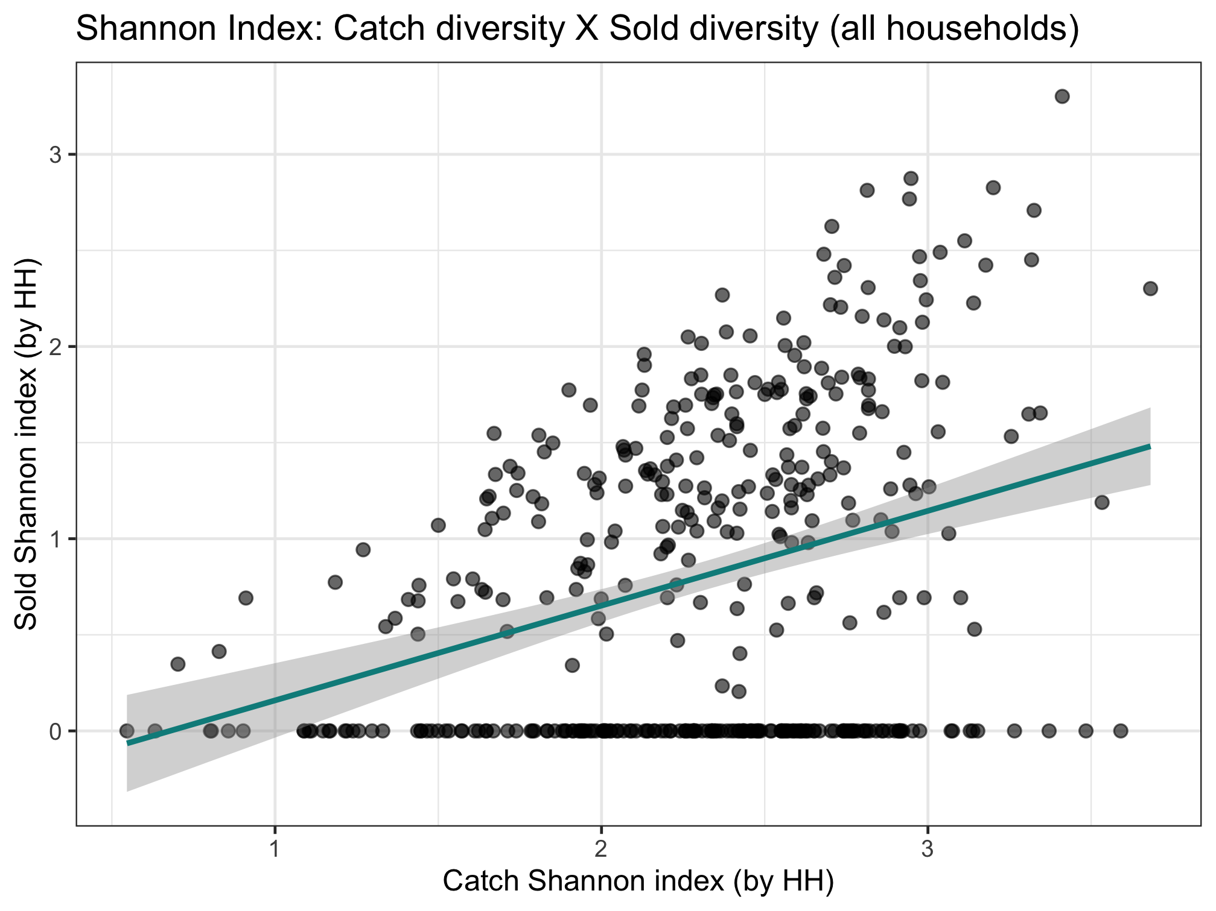
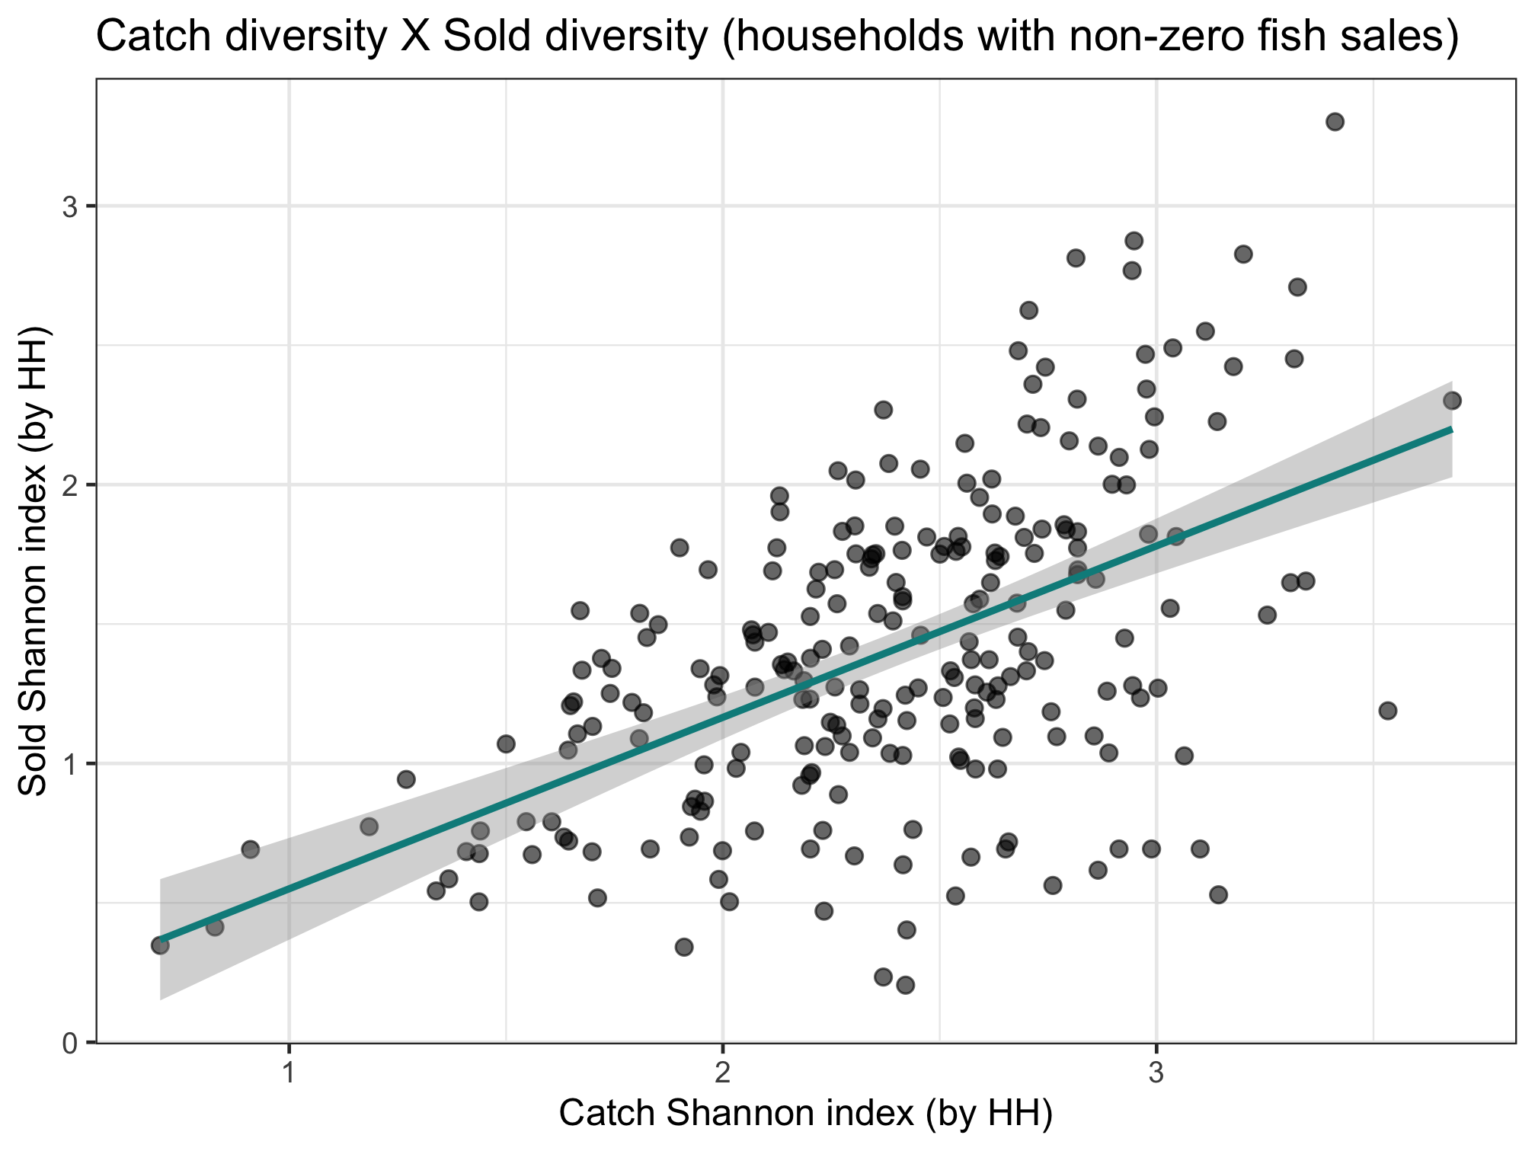
Key point:
Sold species are selective.
Catch and consumption are in lock step. Much accounting includes only sold, which isn't as linked to what is in the ecosystem. Disprefered sale species are underrecognized
Nutrient diversity in the food system
Sold diversity
Slope = 0.287
System diversity
Catch diversity
Consumption diversity
Nutrient diversity in household diets
Slope = 0.493

Slide 7
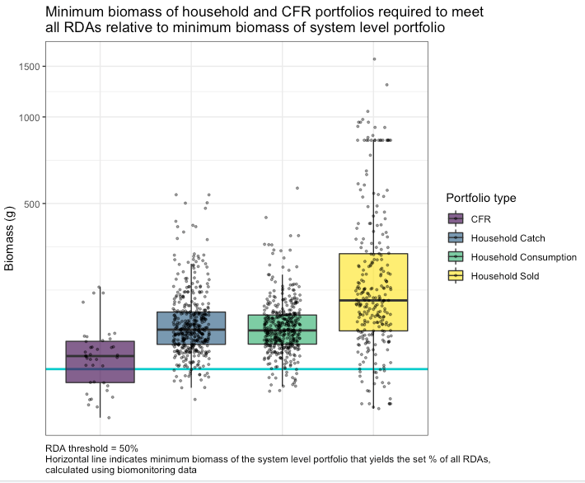
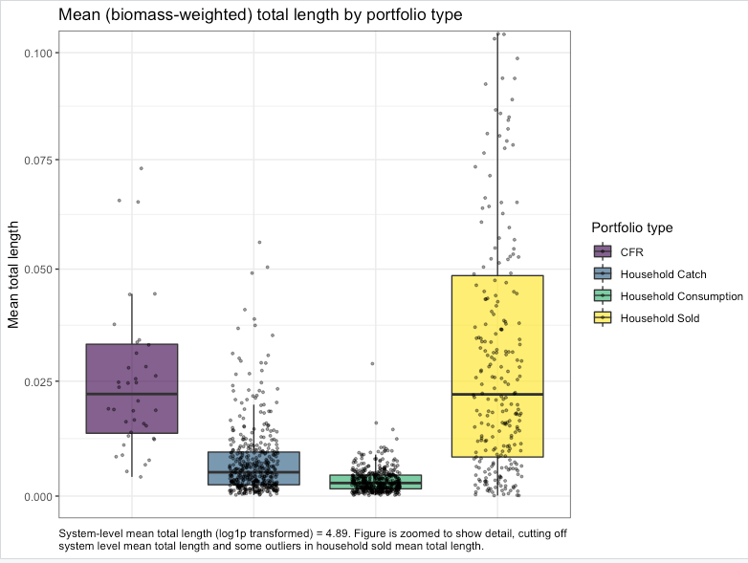
Get rid of legend. Color points by number of species.

Slide 8
New slides as of 10/27
Terminology for the next few slides
“Relationship of interest”:
Relationship 1: System diversity and catch diversity
Relationship 2: Catch diversity and consumption diversity
Relationship 3: Catch diversity and sold diversity
“Specifications”:
Four specifications:
Base (no controls)—just core predictor in relationship of interest
HH characteristics
Add market distance
Interact market distance
I only show two tables in the next few slides as examples, but I have run all combos of relationships of interest and specifications using species count and Shannon index (12 tables total) and can show you anything you’re interested in. For all relationships of interest, I test whether different specifications change the magnitude of the coefficient on the core predictor across specifications (spoiler: they never do).

Slide 9
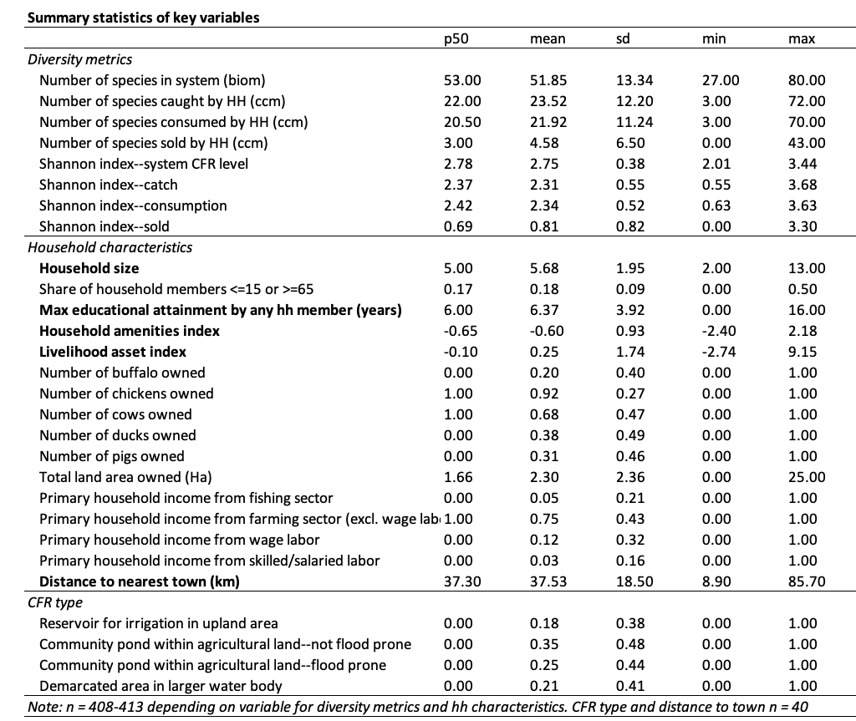
Household characteristics included in current models (bold in table):
Number of household members (household size)
Maximum educational attainment of any household member in years
Household amenities asset index (housing materials etc)
Livelihood asset index (includes fishing gear, agricultural equipment, etc)
Distance to nearest city (among Battambang, Pursat, Kampong Thom and Siem Reap) as a proxy for distance to market.

Slide 10
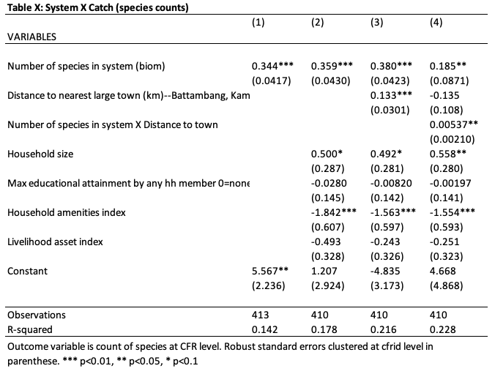
Model example: Relationship 1--System diversity and catch diversity as measured by species counts
Specification (each specification below repeated for each relationship of interest):
Base (no controls)—just core predictor
HH characteristics
Add market distance
Interact market distance
As we add covariates, our explanatory power increases (R2) but this does not attenuate or enhance the effect of core predictor.
All coefficients on core predictors are not statistically different across the 4 specifications (true for each relationship of interest).
Interaction is significant (see next slide)
Table on left is repeated for each relationship of interest (catch x system, cons x catch, sold x catch) and patterns described above are similar.

Slide 11
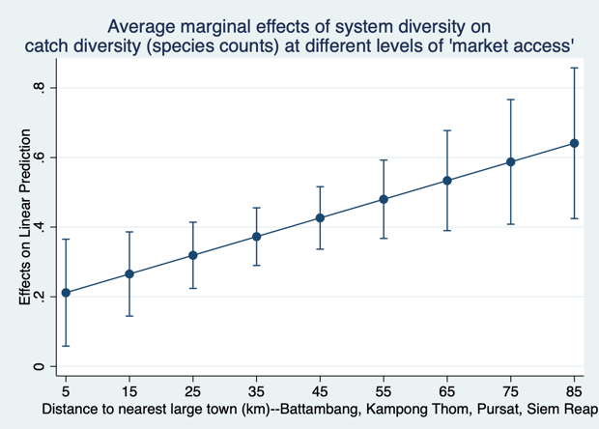
Interaction:
The “effect” of system diversity on catch diversity increases with distance from town.
When number of species in the system increases by 1, the increase in number of species caught ranges from 0.21 to 0.64.

Slide 12
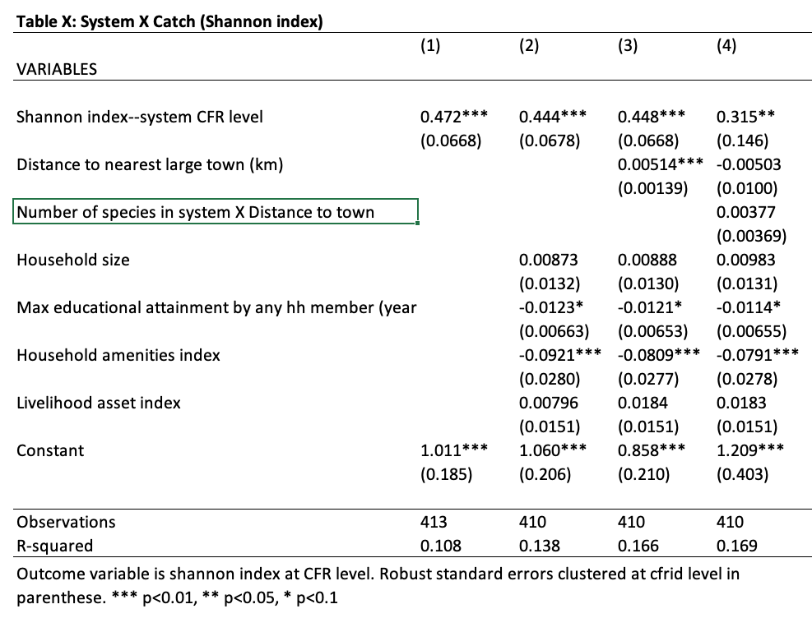
Model example: Relationship 1--system diversity and catch diversity as measured by Shannon index
Initial patterns for Shannon index are roughly similar to species counts.
All coefficients on core predictors are not statistically different across the 4 specifications (and all three relationships of interest)

Slide 13
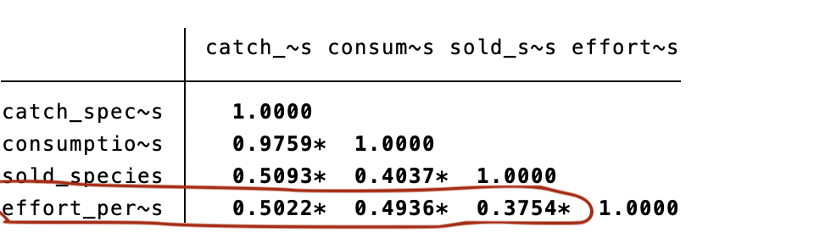
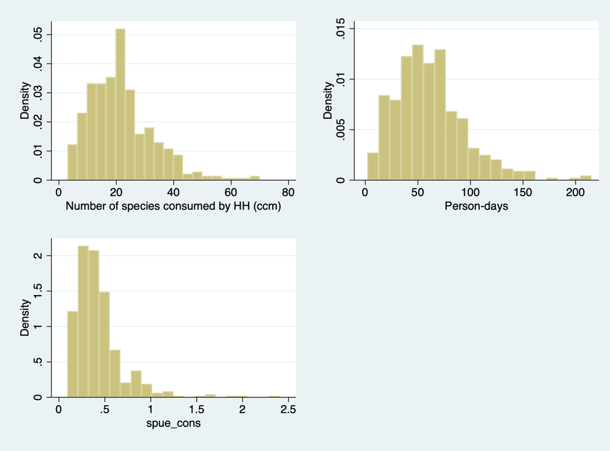
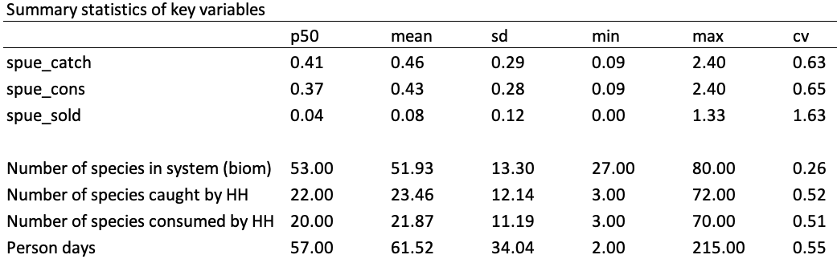
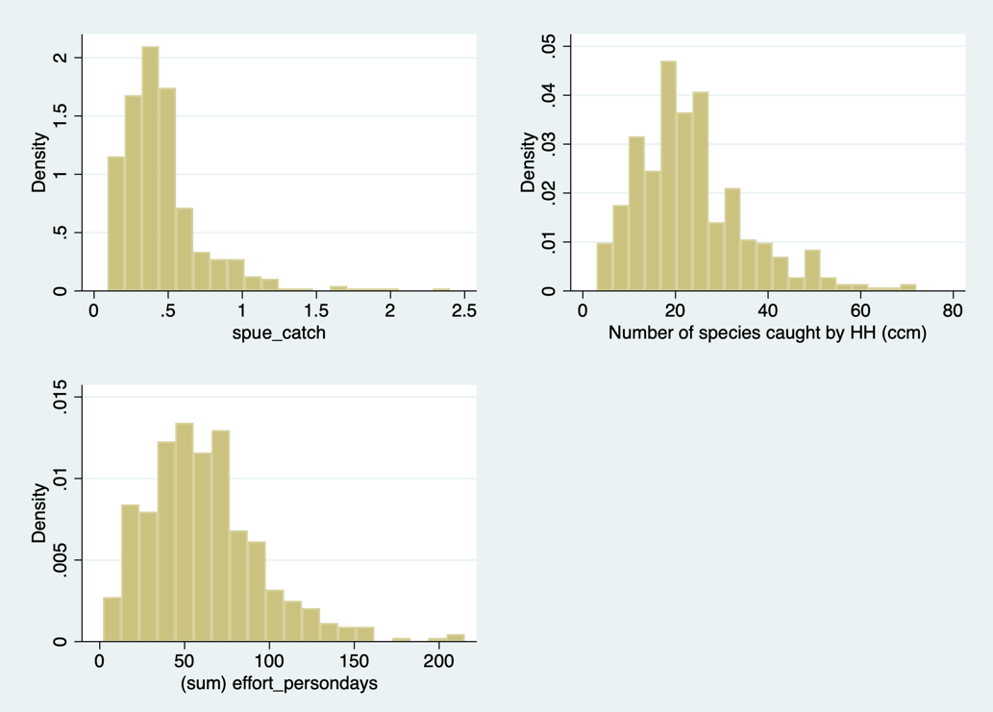
Lots of correlation between effort and number of species caught/consumed/sold

Slide 14
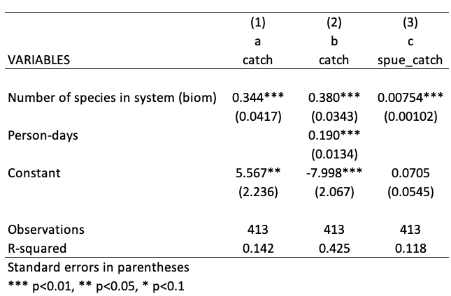

Explanatory power of model c lower because variation associated with effort has been removed from dependent variable.
How do you interpret the coefficient circled in orange? When the number of species in the biomonitoring data goes up by 1, the catch per person-day by households goes up by 0.00754 species?
Interpretation-wise, I don’t like that the units are different for system diversity and catch diversity so I generally prefer the second model.

Slide 15
Past graphs and notes…

Slide 16
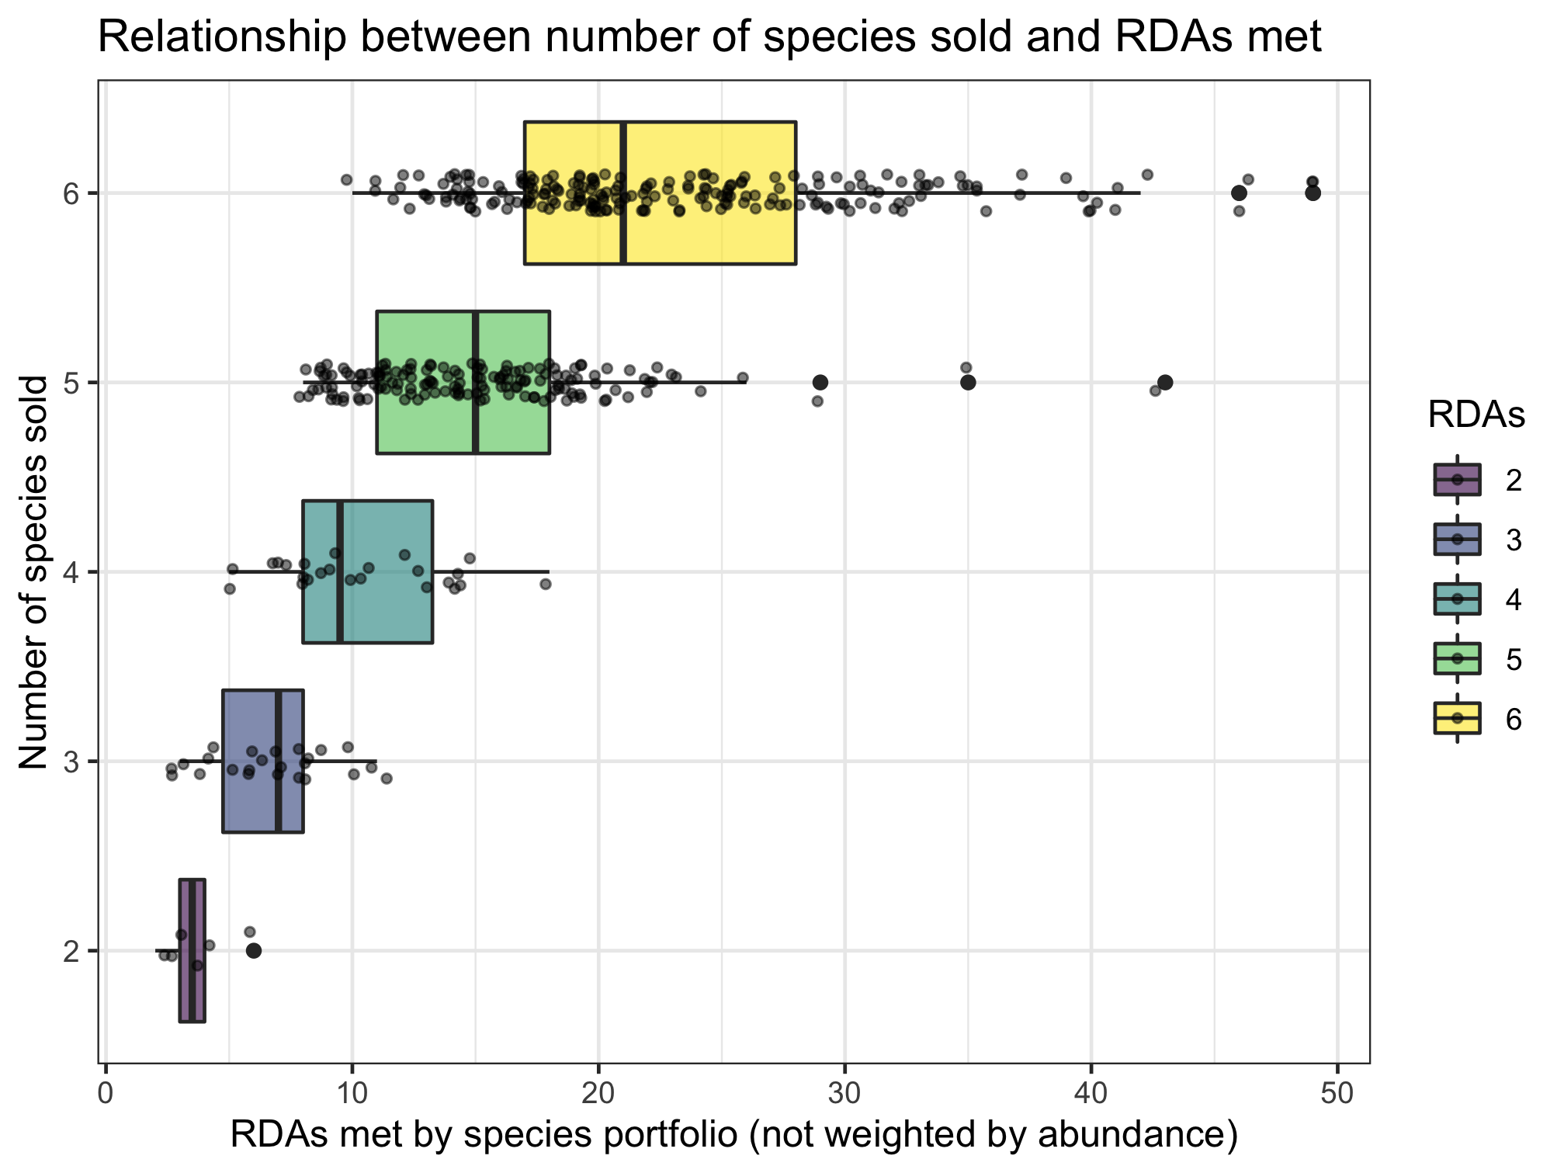
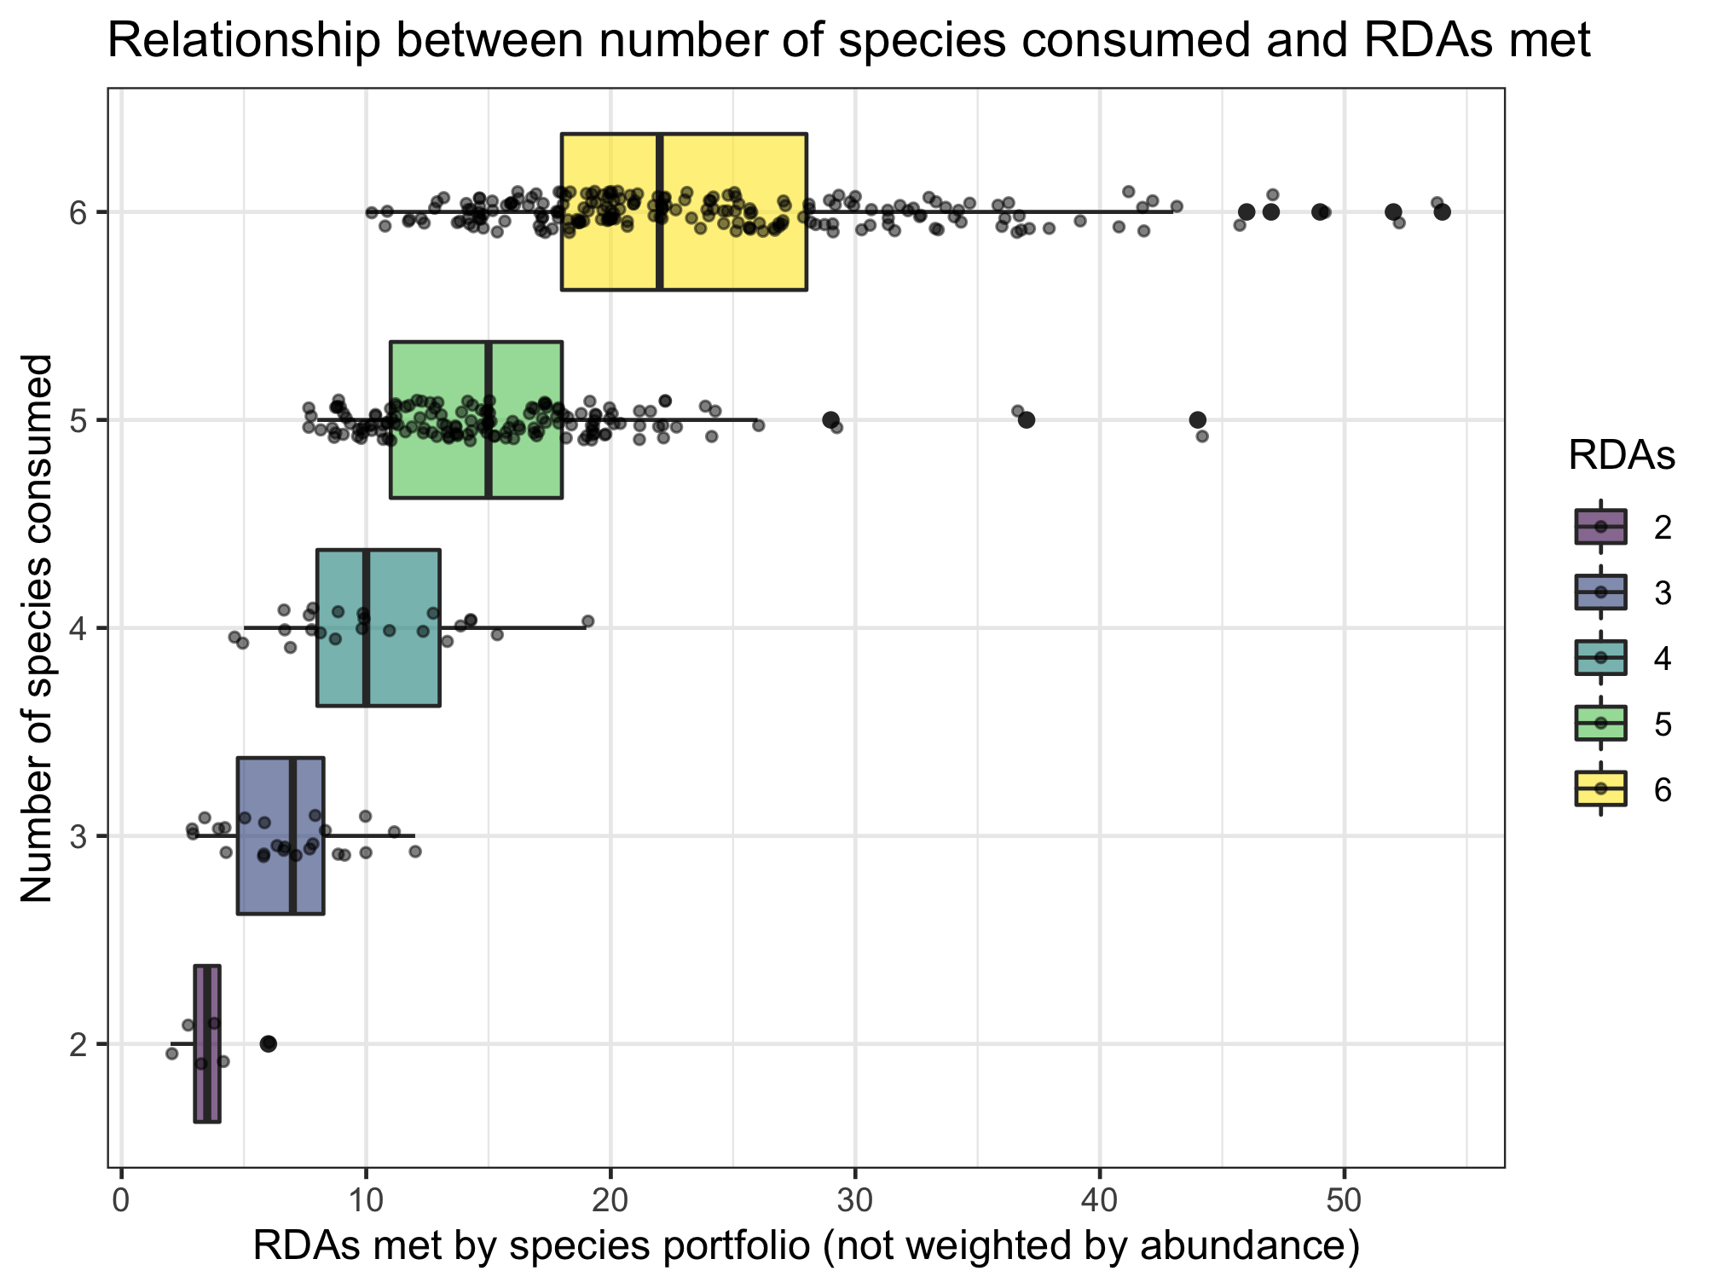
Nutrient diversity in the food system
Sold diversity
System diversity
Catch diversity
Consumption diversity
Nutrient diversity in household diets
Slopes if RDAs treated as continuous:
0.701 (sold)
0.697 (consumed)

Slide 17
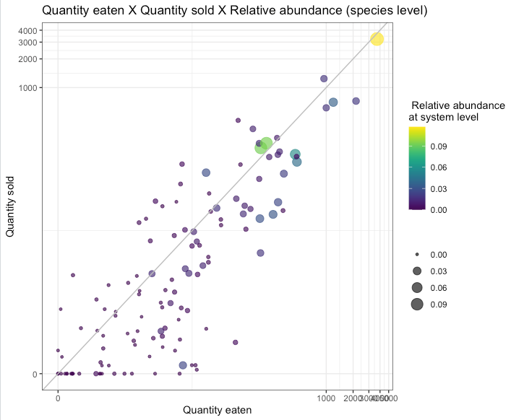
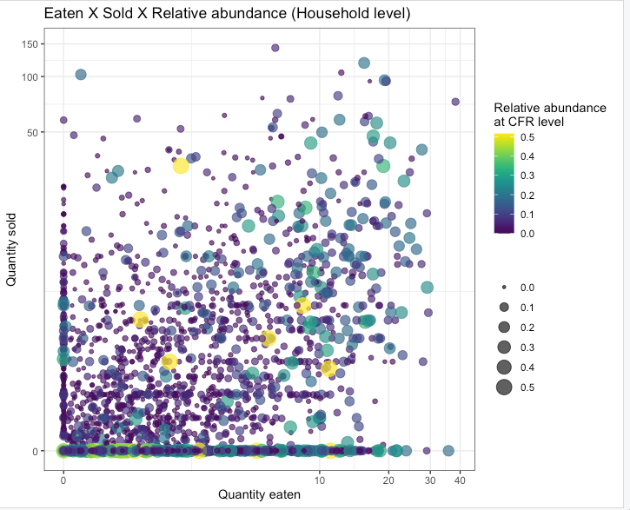
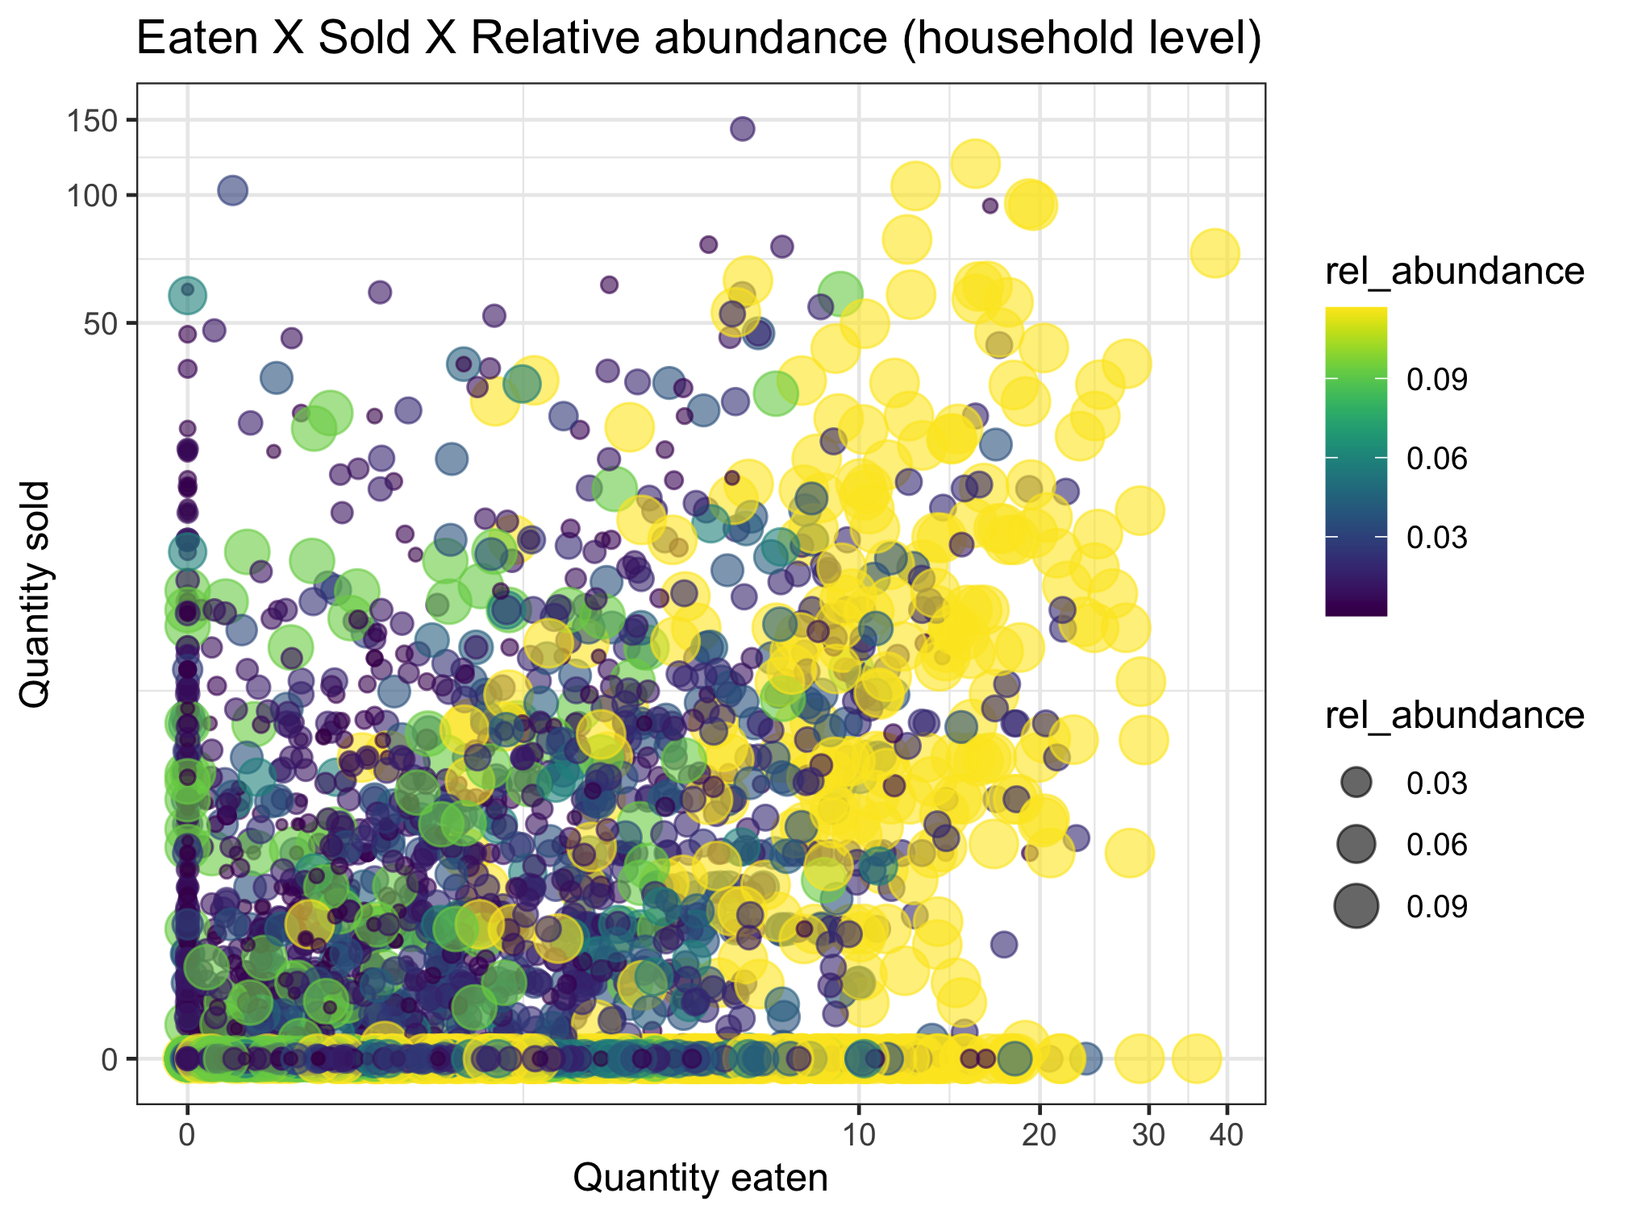
This uses relative abundance at the system level.
Nutrient diversity in the food system
Sold diversity
System diversity
Catch diversity
Consumption diversity
Nutrient diversity in household diets
Conclusion: abundance doesn’t necessarily drive sale or consumption

Slide 18
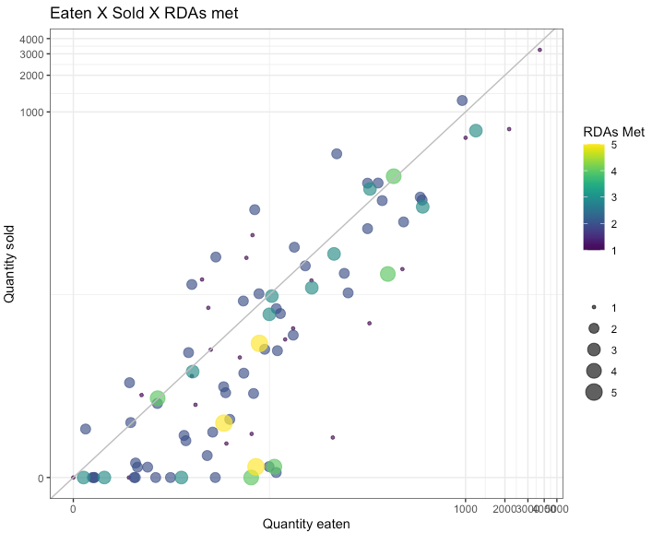
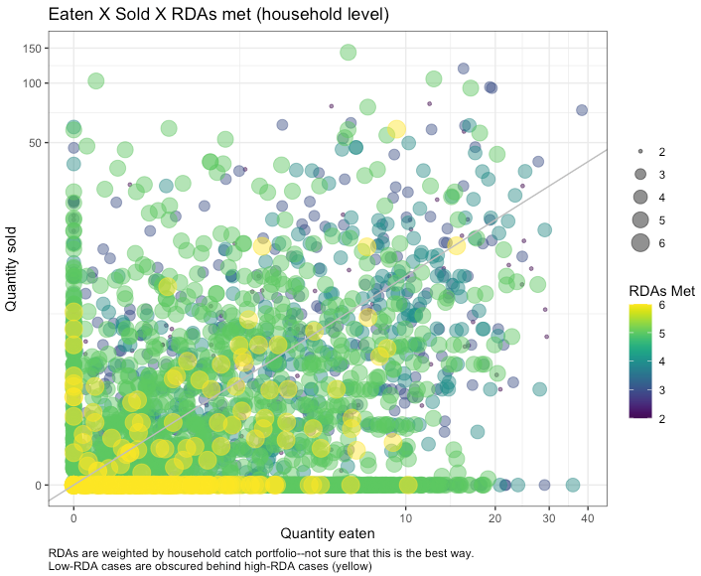
Nutrient diversity in the food system
Sold diversity
System diversity
Catch diversity
Consumption diversity
Nutrient diversity in household diets
Is this a small fish effect?
Yellow (high RDA) means whatever the last nutrient is (VitA or calcium (small fish)
We wanted to weight the RDAs by relative abundance, but within which portfolio level? These are weighted by household-level catch portfolio. Need to think more about the implications of this.
Low-RDA fish are obscured by high-RDA fish. Sorting differently doesn’t help much, but highlights that there are many low-RDA fish along the X axis.
Maybe this should be plotted at a higher level (e.g. CFR?)

Slide 19
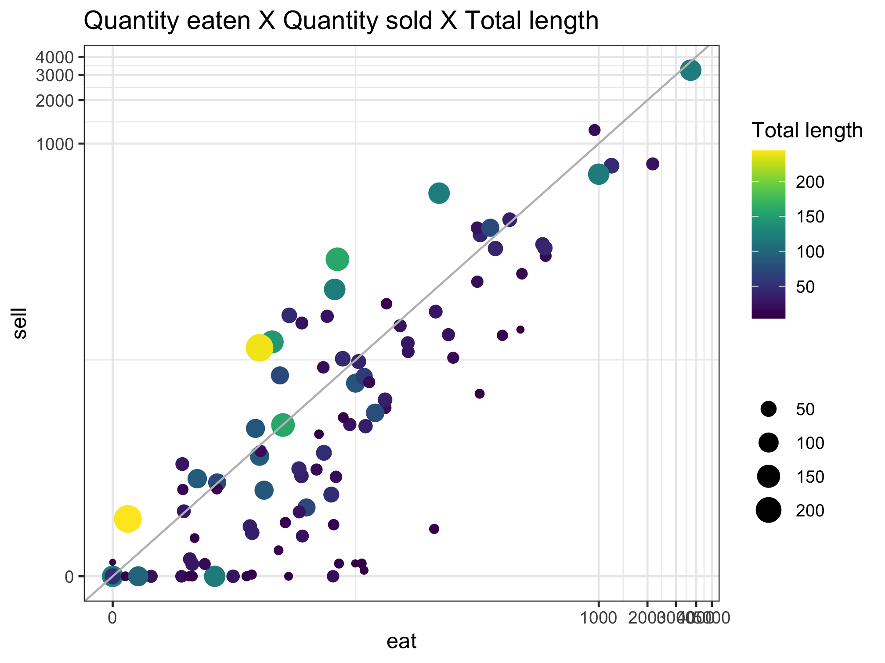
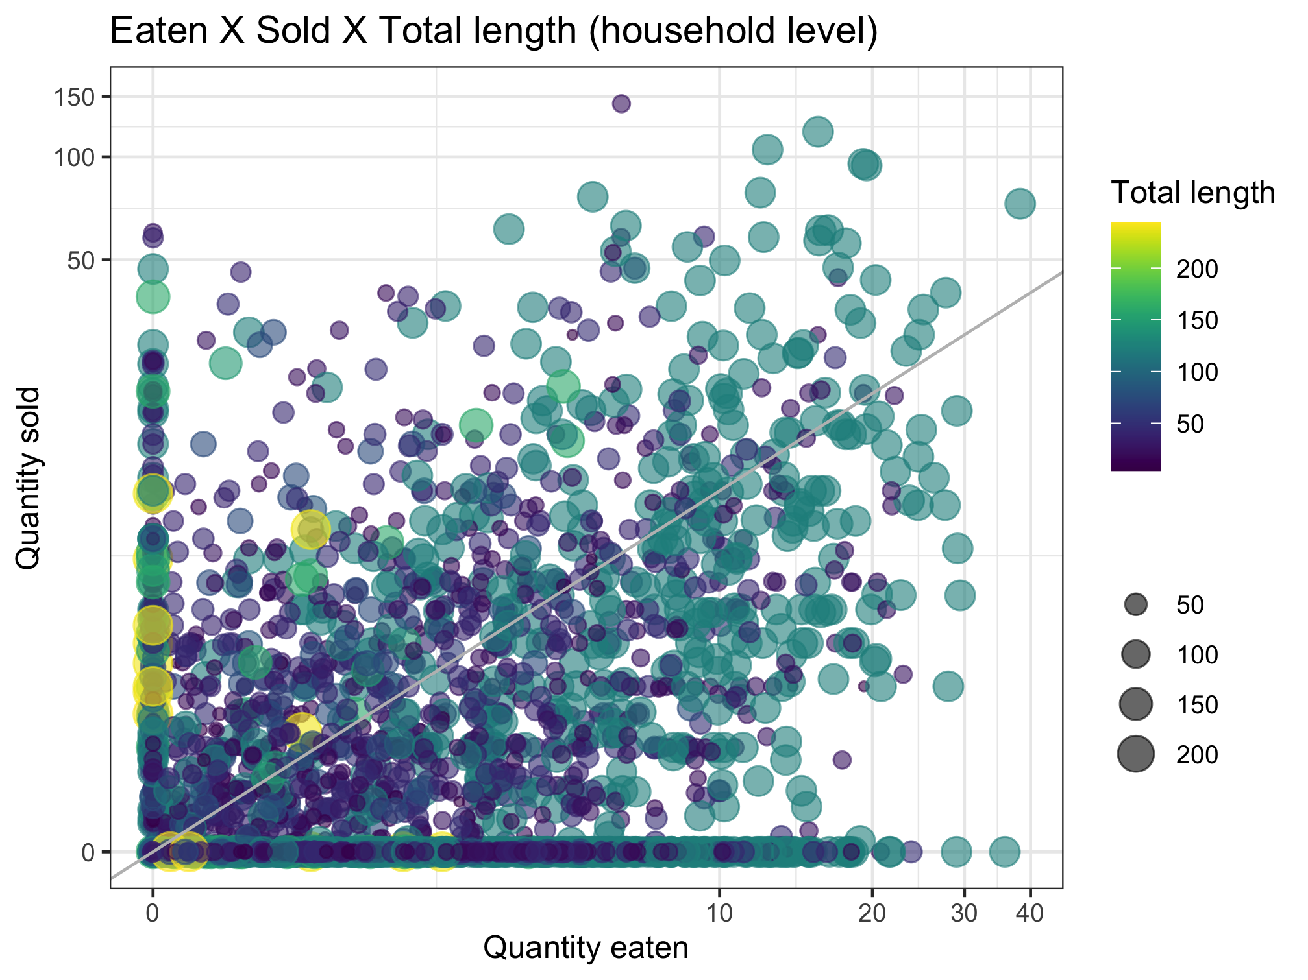
Nutrient diversity in the food system
Sold diversity
System diversity
Catch diversity
Consumption diversity
Nutrient diversity in household diets

Slide 20
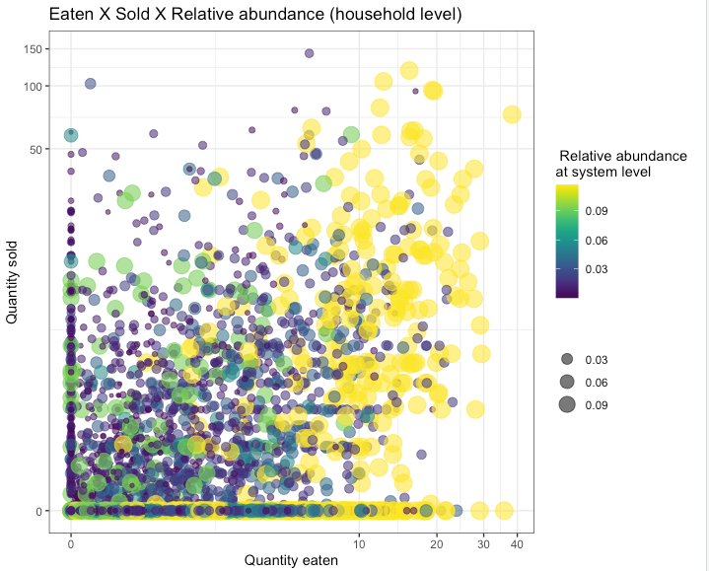
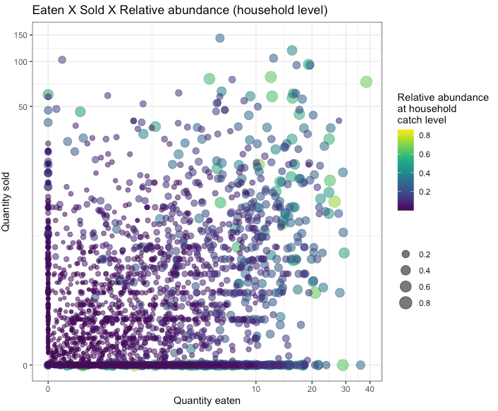
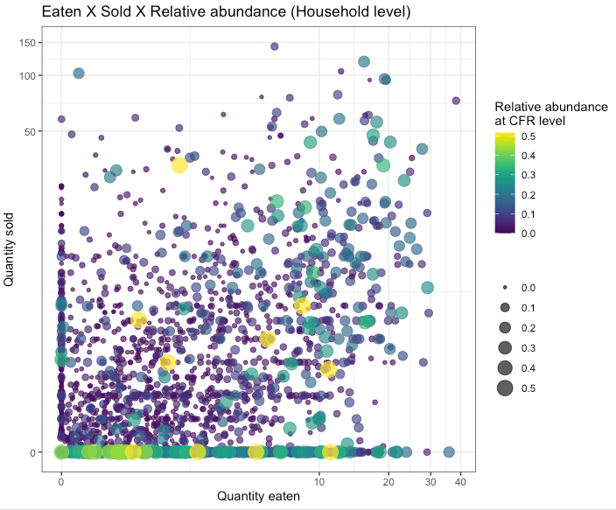
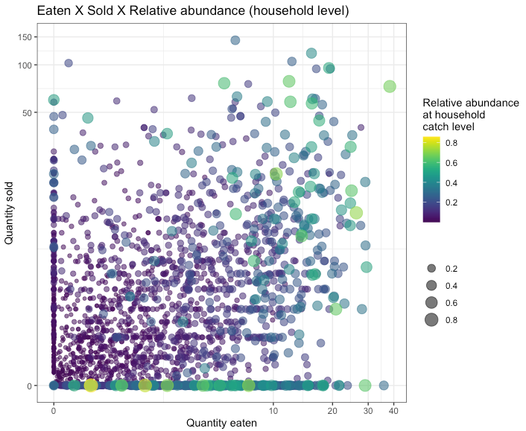
Question: Does species abundance matter for the decision between selling and eating?
Relative abundance in the system
Relative abundance in CFR
Relative abundance in household catch
More abundant species appear to be eaten more than sold. Scatter plots may not tell whole story.
Next slide unpacks this further.
Same as above, but with reverse sorting so high abundance is more visible
Same as above, but with reverse sorting so high abundance is more visible

Slide 21
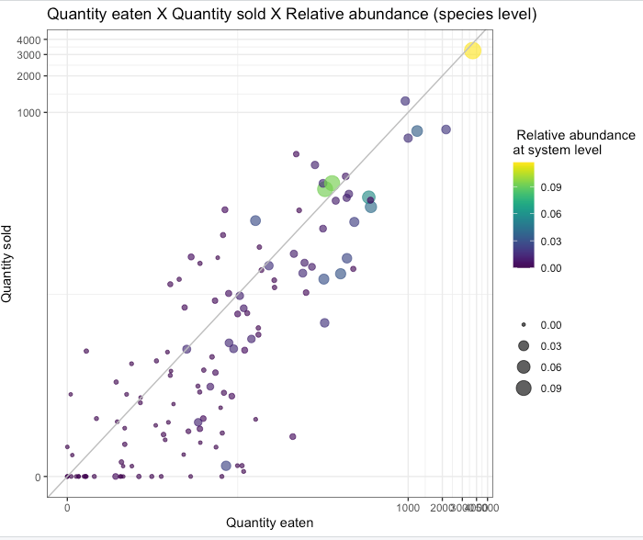
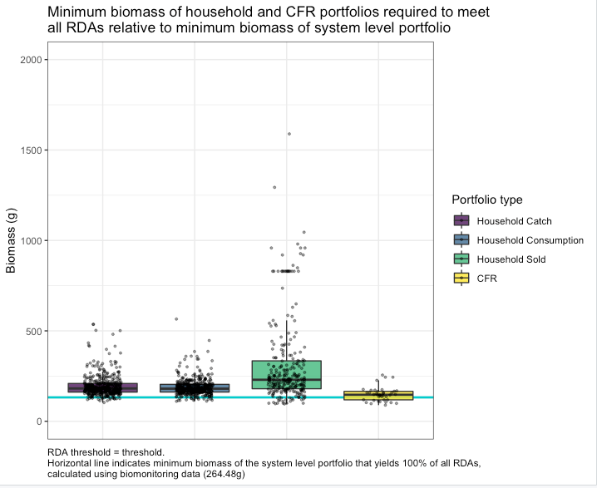
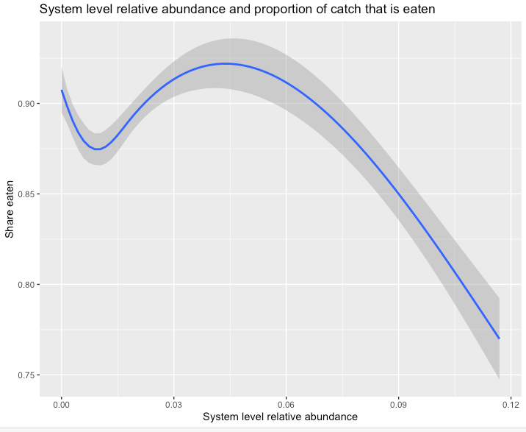
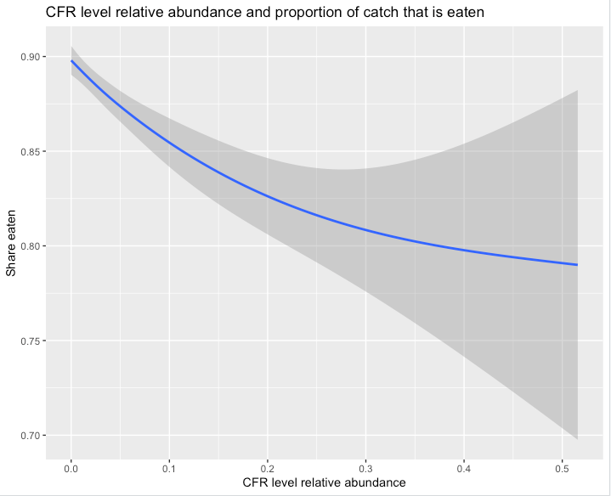
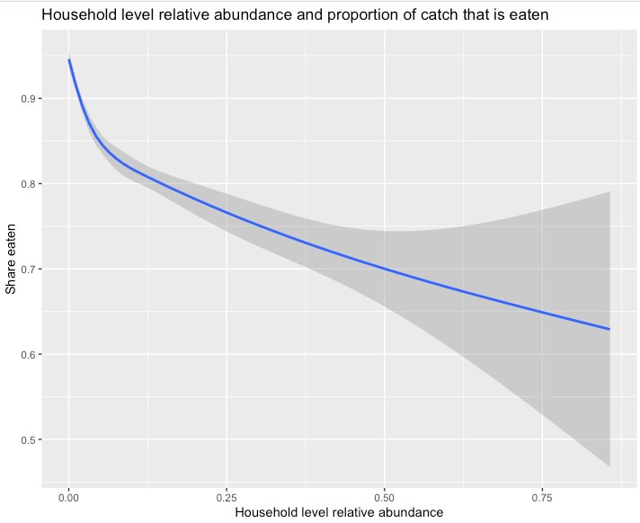
Question: Does species abundance matter for the decision between selling and eating?
Relative abundance in the system
Relative abundance in CFR
Relative abundance in household catch
Spearman correlation coefficient between abundance and share eaten = -0.107
Spearman correlation coefficient between abundance and share eaten = -0.129
Spearman correlation coefficient between abundance and share eaten = -0.275

Slide 22
Sebastian’s thoughts 20220929
Nestedness is a method
Filtering is a process
Framing should be around filtering, with nestedness as a tool that we might use to understand it
“Community assembly to understand the filters that apply from fish available in the environment to fish available on people’s plates”

